Slide 1
IT’S ELEMENTARY, MY DEAR-PRIMARY SOURCES IN THE ELEMENTARY CLASSROOM
Dr. Tammara Purdin
Dr. Kacie Nadeau
Carol LaVallee M.Ed

Slide 2
FLORIDA COUNCIL FOR HISTORY EDUCATION
Introduction of FLCHE members
Dr. Tammara Purdin
Dr. Kacie Nadeau
Carol LaVallee M.Ed
flche.net
This workshop is sponsored in part by the Library of Congress Teaching with Primary Sources Eastern Region Program, coordinated by Waynesburg University.

Slide 3
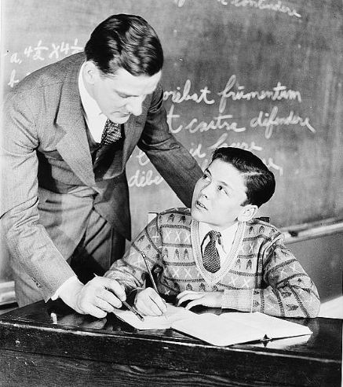
WHY WE’RE HERE
Overview of TPS Grant
Expectations of participants
Participants will get paid
Questions?
Teacher and pupil, Roberts ,H. Armstrong,-photographer
1930-1935[?] https://lccn.loc.gov/2017759175

Slide 4
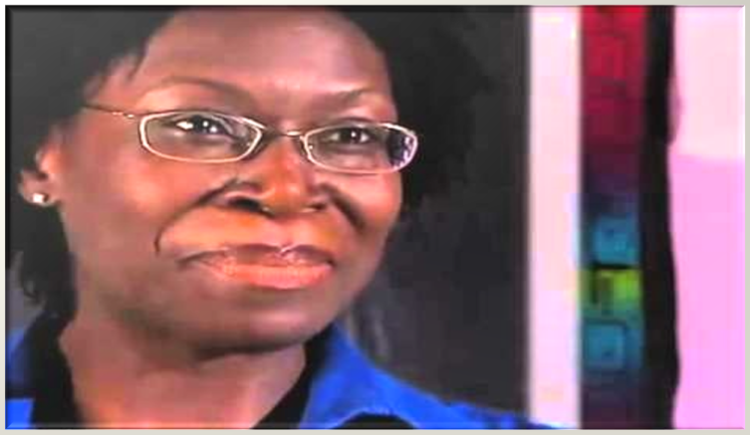
TEACHING WITH PRIMARY SOURCES MADE A REAL CHANGE
https://youtu.be/HVPVjEPM9xk

Slide 5
WHY ARE PRIMARY SOURCES IMPORTANT AT THE ELEMENTARY LEVEL
Dr. Bernadette Bennett
Ms. Tracy Prince
Program Specialists of Sarasota County School

Slide 6
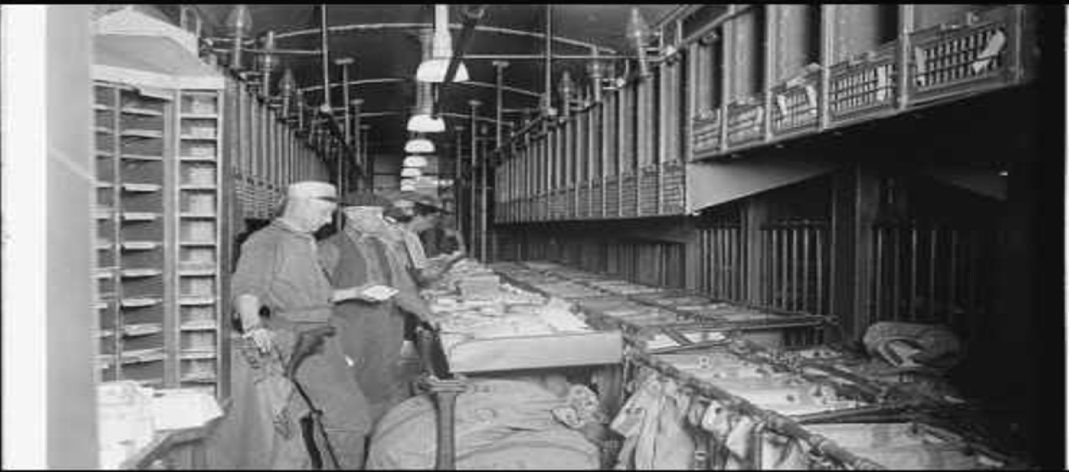
ENGAGING YOUNG LEARNERS WITH PRIMARY SOURCES
VIDEO
https://youtu.be/RKC88CW3h00

Slide 7
MIND WALK ACTIVITY TEACHING WITH PRIMARY SOURCES
Mrs. Blair Banister, Assistant to the Treasurer of the United States takes a look in the family purse before attending the annual dinner of the National Women's Press Club [1936-1937]
Think about all the activities you were involved in during the past 24 hours.
Do you have any evidence of these activities on your person, in your purse/wallet, computer bag, etc.

Slide 8
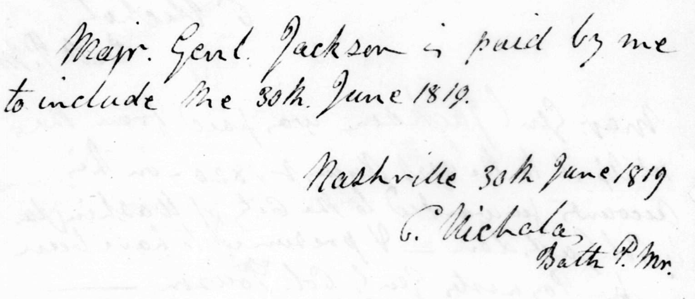
MIND WALK ACTIVITY TEACHING WITH PRIMARY SOURCES
Working in your group, list as many activities you were involved in during the past 24 hours on a piece of paper.
Next, write down what evidence, if any, these activities might have left behind. (receipts, notes, text messages, security surveillance data, signed credit card documents, voice messages, etc.)
Receipt from Cary Nicholas to Andrew Jackson, December 31, 1820

Slide 9
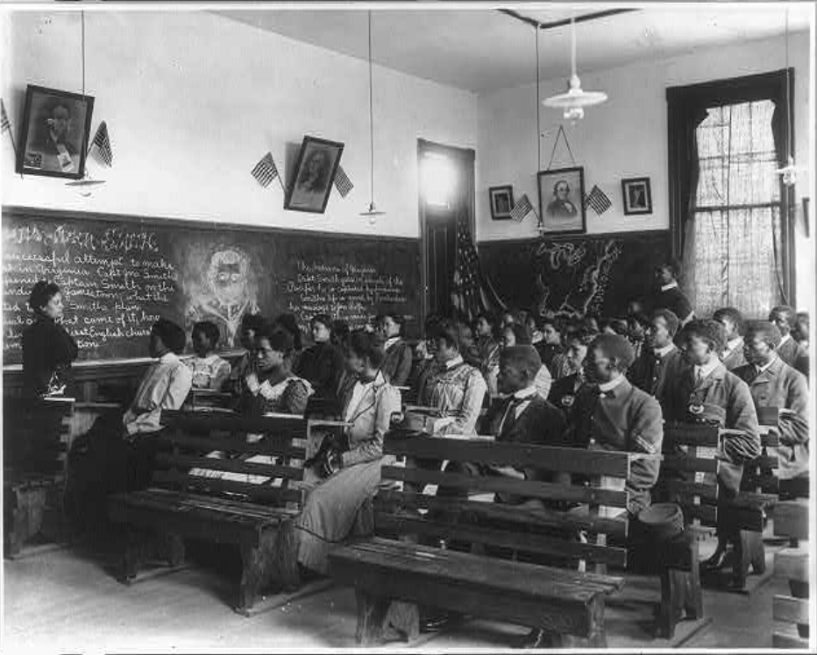
MIND WALK ACTIVITY TEACHING WITH PRIMARY SOURCES
PRIMARY SOURCES are the raw materials of history--original documents and object which were created at the time.
Discuss with your group:
Is the evidence that you listed constitution as a primary source?
[History class, Tuskegee Institute, Tuskegee, Alabama] 1902

Slide 10
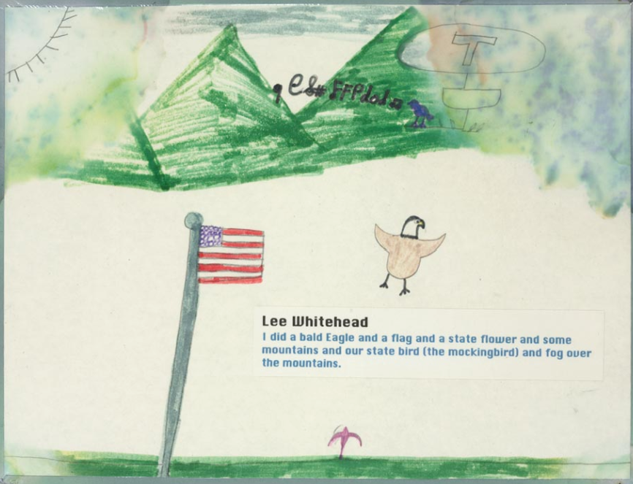
MIND WALK ACTIVITY TEACHING WITH PRIMARY SOURCES
Continue your group discussion based on these questions:
Which of your daily activities were most likely to leave trace evidence behind?
What, if any, of that evidence might be preserved for the future? Why?
What would a person from the future be able to tell about your life and your society based on evidence of your daily activities that might be preserved for the future?
I Did a Bald Eagle-Whitehead, Lee (Artist),
September 11 Terrorist Attacks, 2001

Slide 11
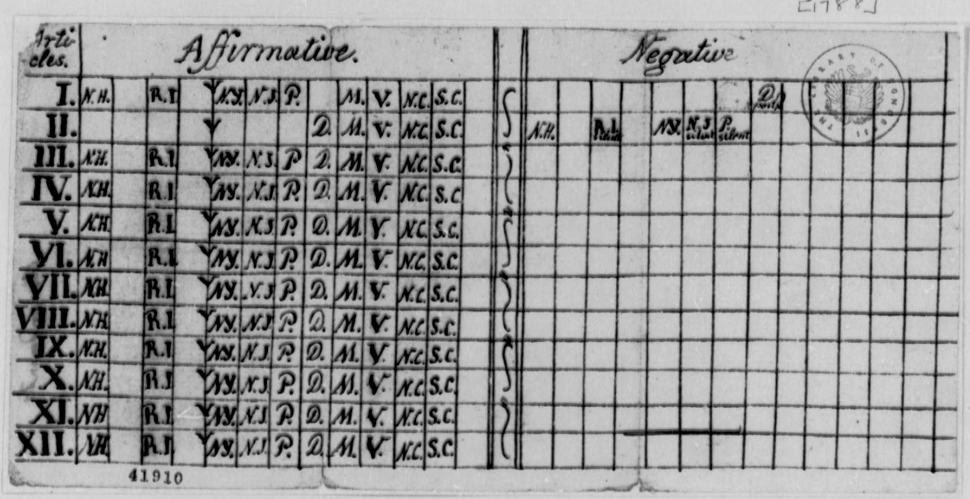
MIND WALK ACTIVITY TEACHING WITH PRIMARY SOURCES
Think of a public event currently happening (a court case, election, public controversy, law being debated)
What kinds of evidence might this event leave behind? Primary sources?
Who records information about this event? How might their perspective impact their recording?
For what purposes are different records of this event made?
Thomas Jefferson, 1788, Chart of State Votes on the United States Constitution

Slide 12
MIND WALK ACTIVITY TEACHING WITH PRIMARY SOURCES
PRIMARY SOURCES are the raw materials of history--original documents and object which were created at the time.
archives and manuscript material
photographs, audio recordings, video recordings, films
journals, letters and diaries
speeches
government publications
oral histories
written records
autobiographies and memoirs
artifacts, e.g. clothing, costumes, furniture
research data, e.g. public opinion polls
Secondary Sources are accounts or interpretations of events created by someone without firsthand experience.

Slide 13
MIND WALK ACTIVITY TEACHING WITH PRIMARY SOURCES
https://youtu.be/2_9UXHxZYdE

Slide 14
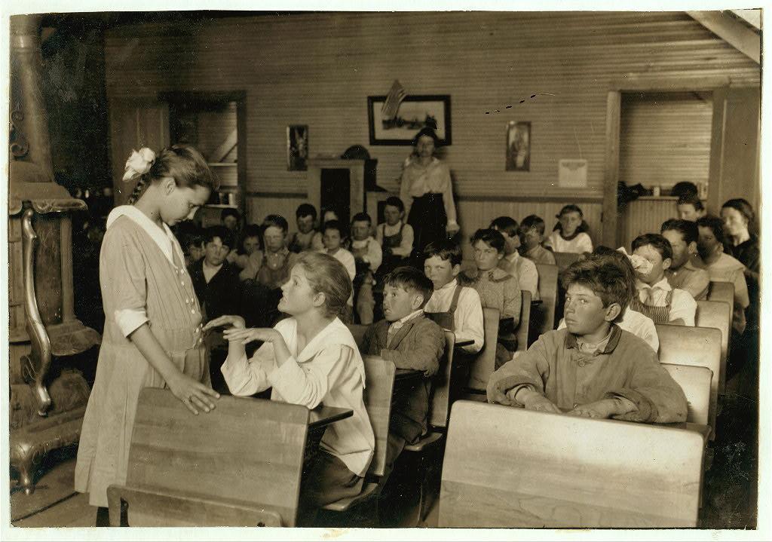
ANALYZING A VISUAL IMAGE ACTIVITY- THE POWER OF IMAGES

Slide 15
ANALYZING A VISUAL IMAGE ACTIVITY- THE POWER OF IMAGES
Divide your photo into four quadrants by folding the paper.
On your worksheet complete “I am examining a PHOTO”
Complete #1 top left.
Complete remaining worksheet.
Complete sentences at bottom.
Discuss answer with group.

Slide 16
ANALYZING A VISUAL IMAGE ACTIVITY- THE POWER OF IMAGES
What is really going on in this photo?

Slide 17
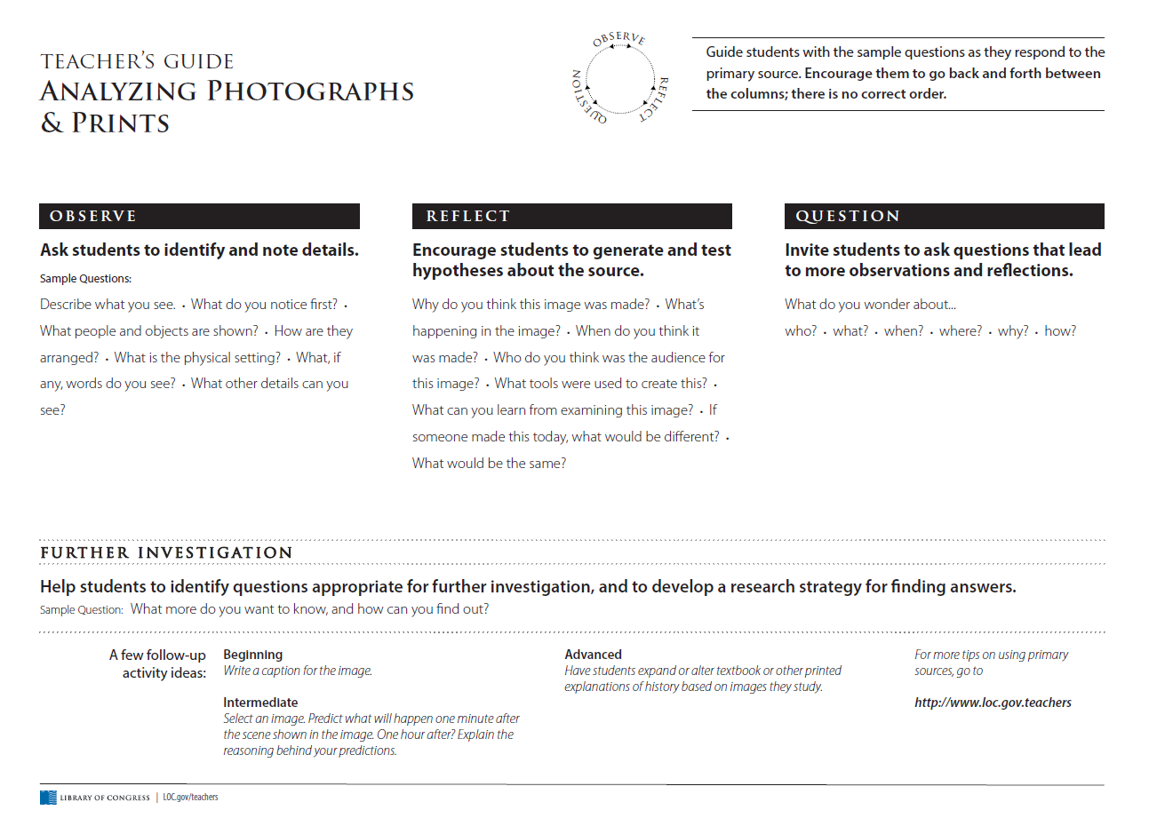
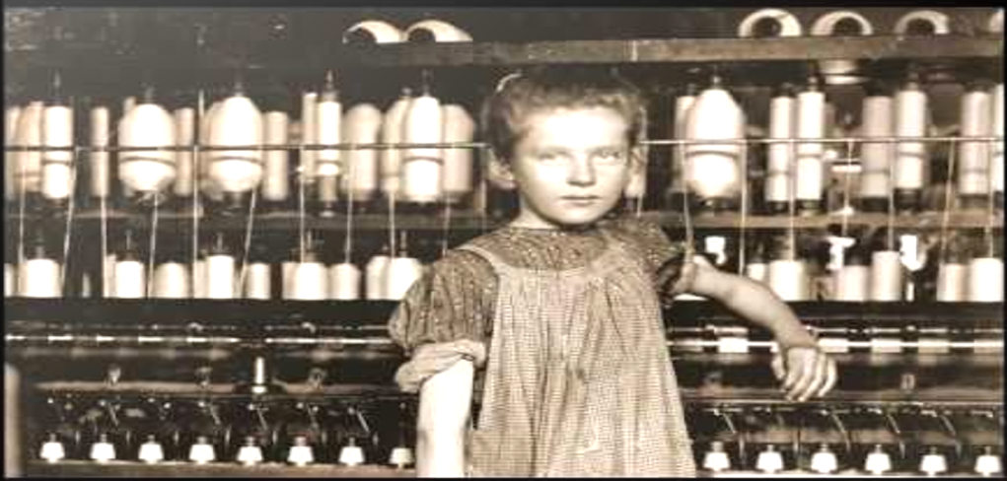
ANALYZING A VISUAL IMAGE ACTIVITY- THE POWER OF IMAGES
https://youtu.be/U45m790pEyA

Slide 18
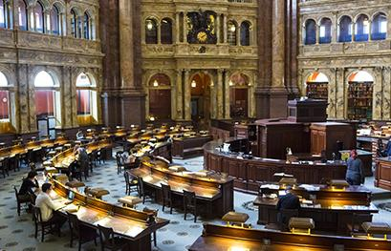
LIBRARY OF CONGRESS- TEACHER RESOURCES
Introduction to LOC Website
Teacher Resources
Teacher's Guides and Analysis Tool

Slide 19
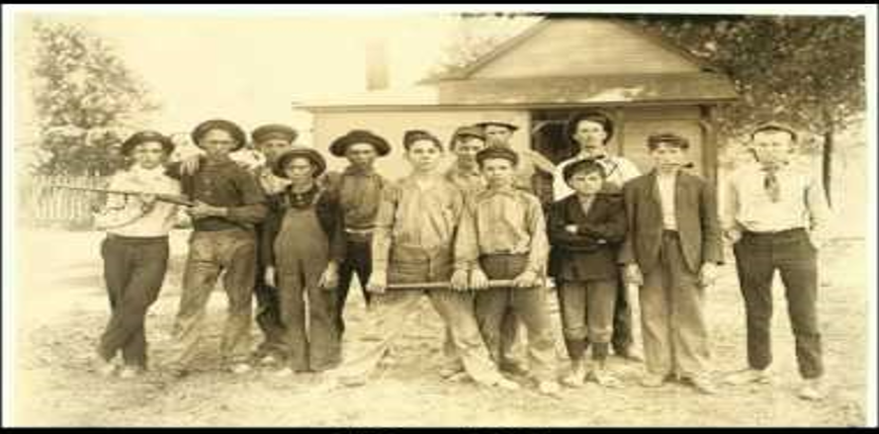
COPYRIGHT QUICK CHECK
https://youtu.be/aMEQYbwquQg

Slide 20
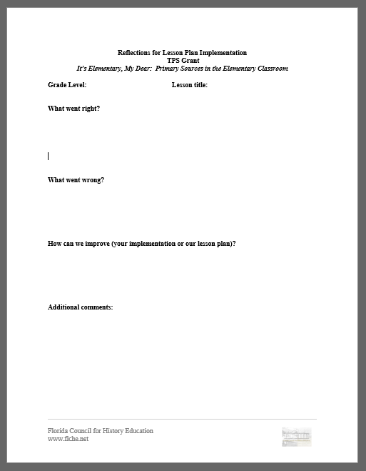
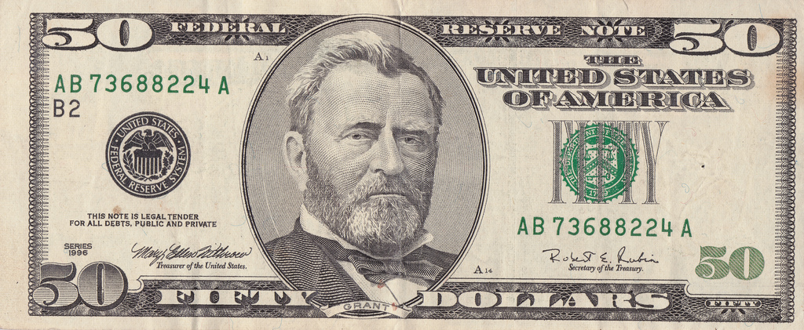
HOMEWORK
Homework-You have been given 2 lesson plans that correlate with your grade level. Select one lesson to implement in your classroom and bring student samples/evidence to the next session. You will be paid $50 to implement.
Lesson plans also available on www.flche.net

Slide 21
QUESTIONS? CONTACT US!
tammarapurdin@flche.net
kacienadeau@flche.net
carollavallee@flche.net

