Slide 1
Engaging Students in History Through Historical Fiction Paired With Primary Sources
Dr. Tammara Purdin
SOURCES Conference 2019

Slide 2
Historical Fiction and Non-Fiction
“Any attempt to equate history with fiction is dangerous, as it allows any interpretation to have equal validity; it creates moral relativism, where those who deny the Holocaust have equal place with those that tell its horrors” (Harris & Foreman-Peck, 2004).
Notes:
History and historical fiction are obviously not the same, and confusing their use is a dangerous practice:

Slide 3
Young people who read historical fiction gain a sense that real people were
involved in history and that times and issues in history were complex (Levstik, 1989).
A positive effect on moral education is identified as readers develop a caring attitude toward the characters (Harold, 2003).
Notes:
I have students in high school and college repeatedly tell me that their favorite book is still ALR.

Slide 4
Integrating subject areas of literacy and history will allow teachers to meet the pressures and allow students to learn the history that they need to develop into future successful democratic citizens (Purdin, 2014).

Slide 5
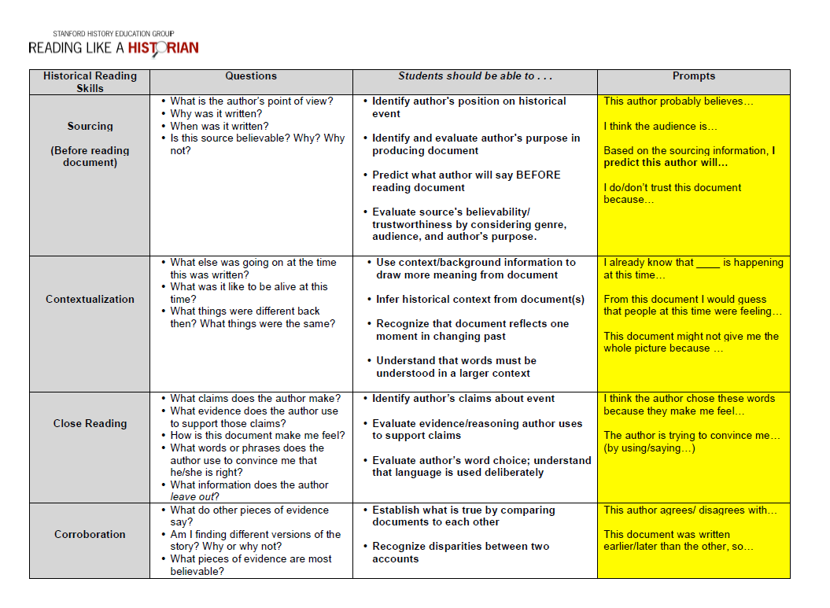
Historical Thinking Skills and ELA skills coincide
determining the author’s intent
determining the context in which the book was written
questioning and interpreting the text, not just comprehending the story
reading critically
being aware of the reader’s positionality (POV)
corroborating the details of the story with primary and secondary sources
using historical evidence to build an imaginative picture of the life described
(Apol et al., 2003; Crocco, 2005; Seixas & Peck, 2004).

Slide 6
Historical Thinking Skills and ELA skills coincide
determining the author’s intent
determining the context in which the book was written
questioning and interpreting the text, not just comprehending the story
reading critically
being aware of the reader’s positionality (POV)
corroborating the details of the story with primary and secondary sources
using historical evidence to build an imaginative picture of the life described
(Apol et al., 2003; Crocco, 2005; Seixas & Peck, 2004).
Sourcing
Contextualizing
Sourcing
Close Reading
Sourcing
Corroborating
Corroborating

Slide 7
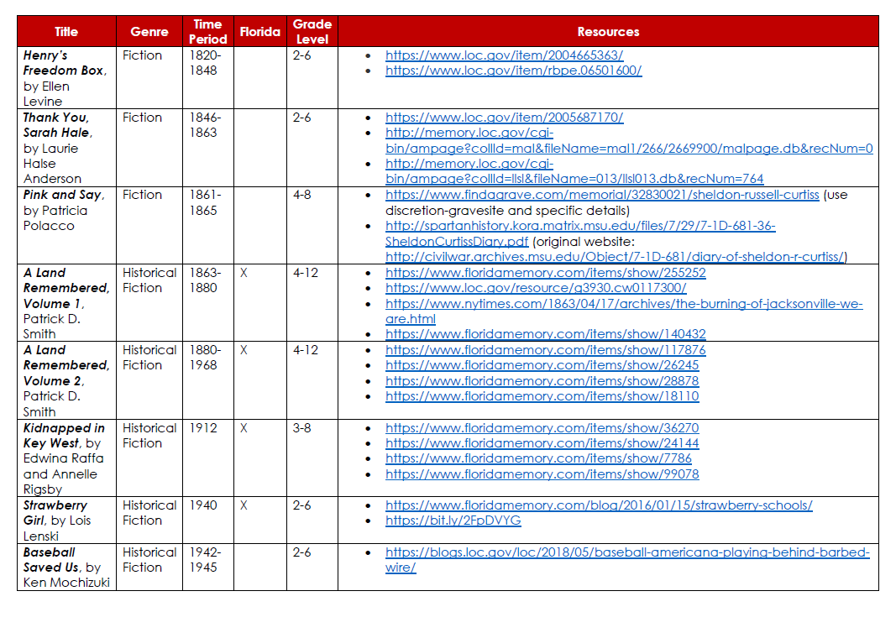
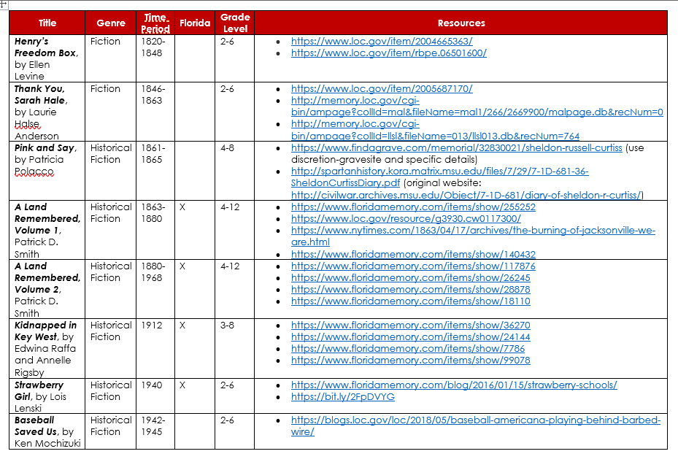

Slide 8
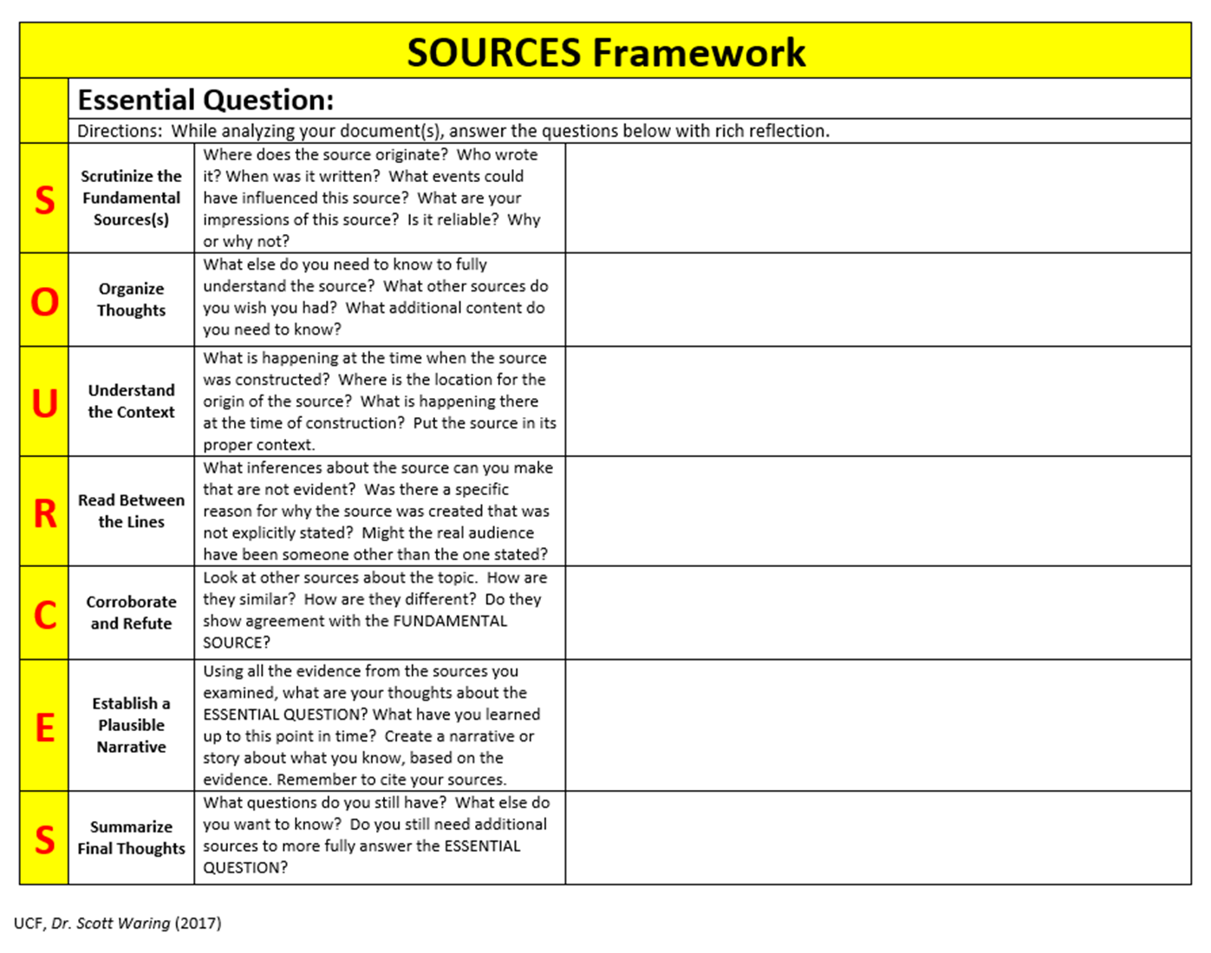

Slide 9
Library of Congress Resources
http://www.loc.gov/teachers/primary-source-analysis-tool/
Teachers Page Features
Lesson Plans --
Themed Resources --
Primary Source Sets --
Presentations & Activities --
Collection Connections --

Slide 10
“We may be uncomfortable talking about race, but we can no longer afford to be silent. We have chosen a profession that—like parenting—requires us to put our comforts second to those of children.”
Jamilah Pitts

Slide 11
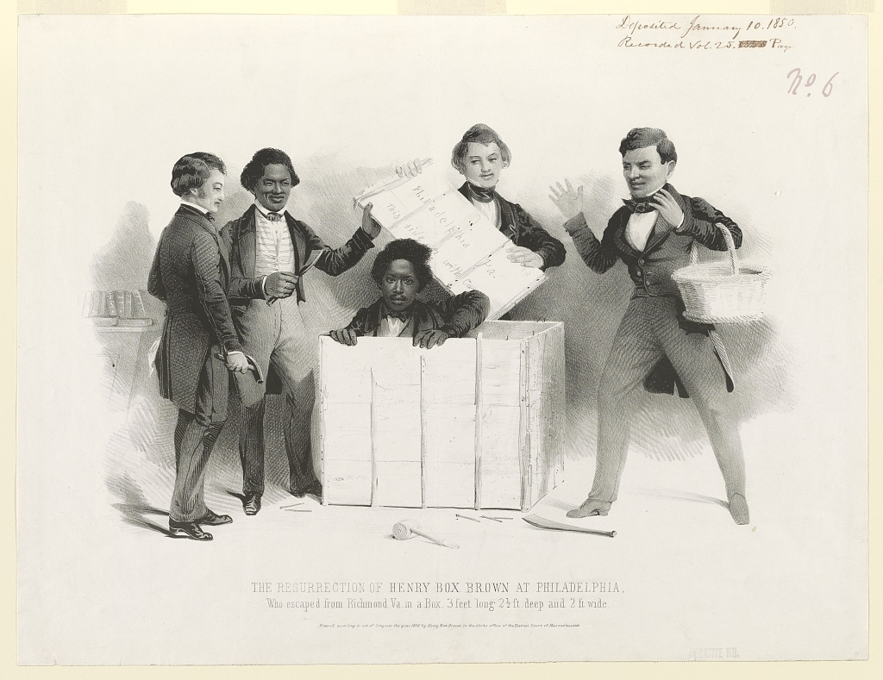
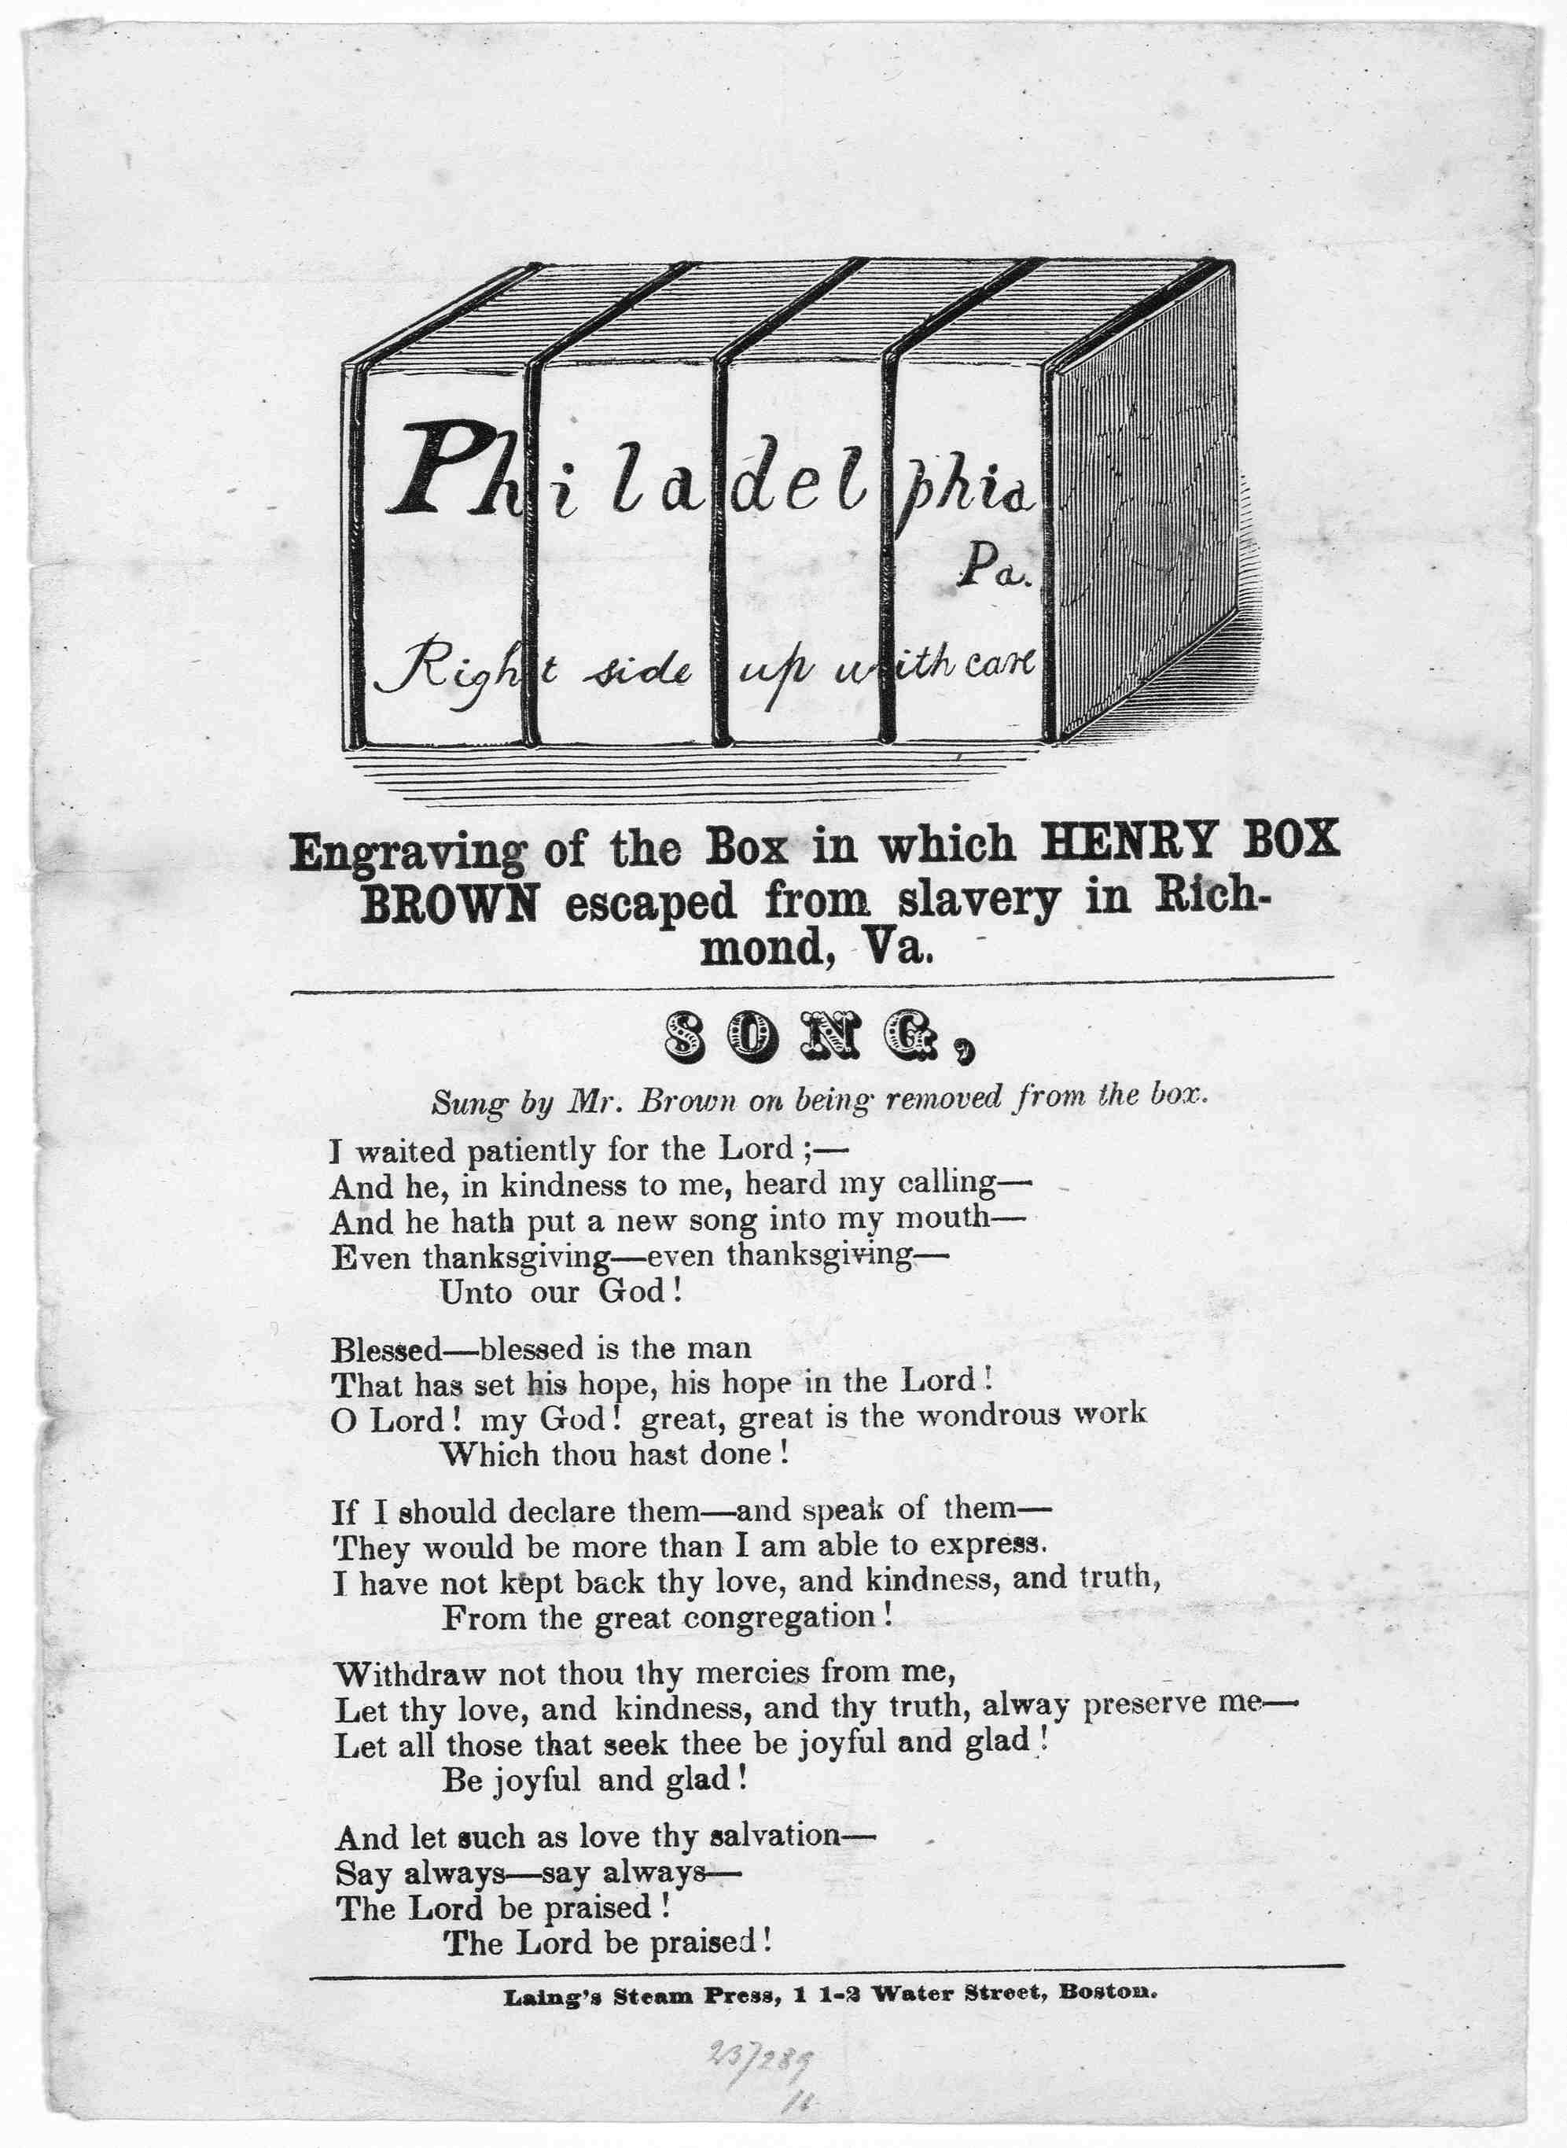
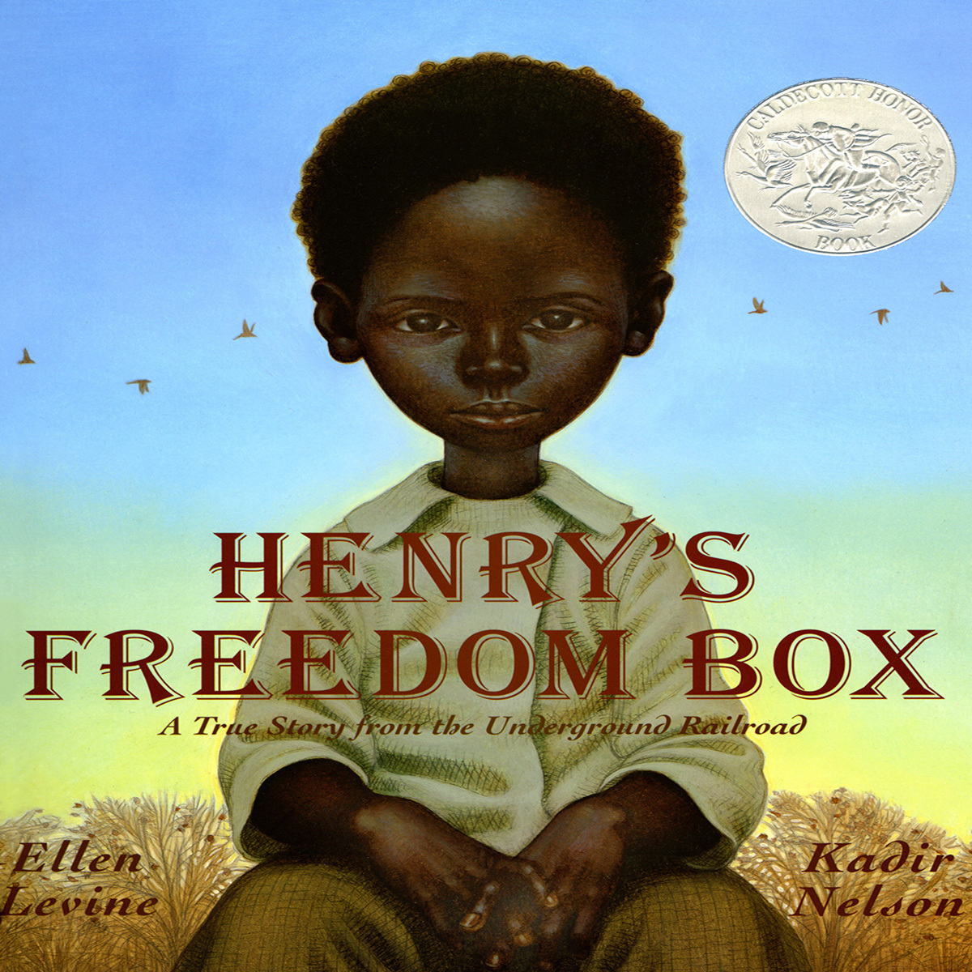
Notes:
A stirring, dramatic story of a slave who mails himself to freedom by a Jane Addams Peace Award-winning author and a Coretta Scott King Award-winning artist.

Slide 12
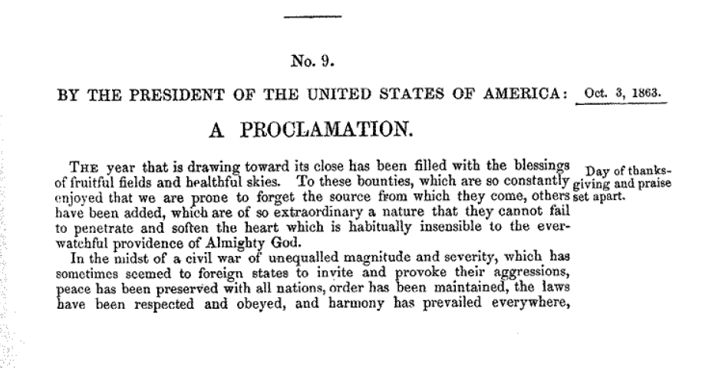
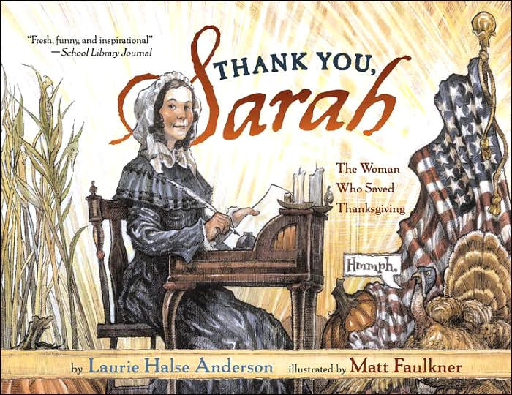
https://www.loc.gov/item/2005687170/ http://memory.loc.gov/cgi-bin/ampage?collId=mal&fileName=mal1/266/2669900/malpage.db&recNum=0 http://memory.loc.gov/cgi-bin/ampage?collId=llsl&fileName=013/llsl013.db&recNum=764

Slide 13
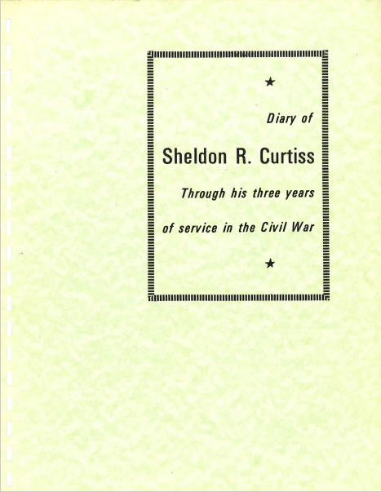
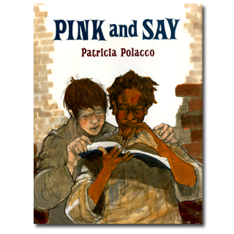
http://spartanhistory.kora.matrix.msu.edu/files/7/29/7-1D-681-36-SheldonCurtissDiary.pdf
Notes:
This story, about how a young black soldier rescues a white soldier, opens young readers' eyes to the injustices of slavery and the senselessness of war. Highly charged emotionally, this masterful retelling of a true story is seen through the white soldier's eyes.

Slide 14
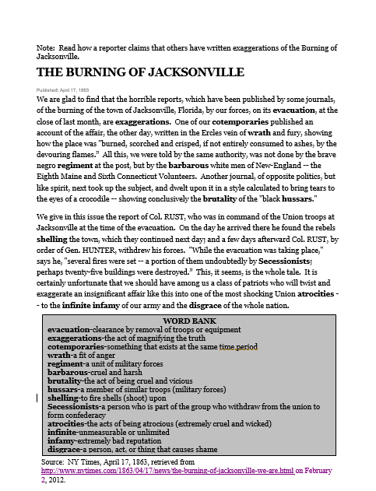
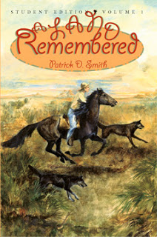

Slide 15
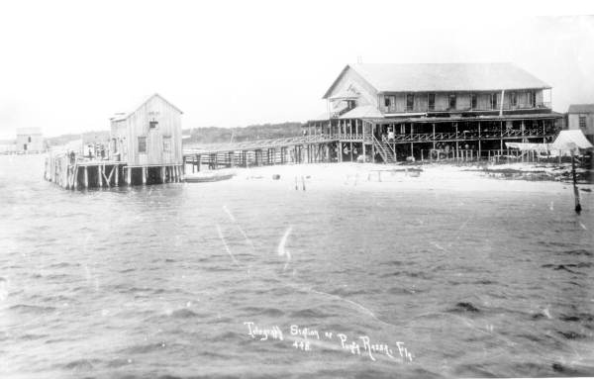
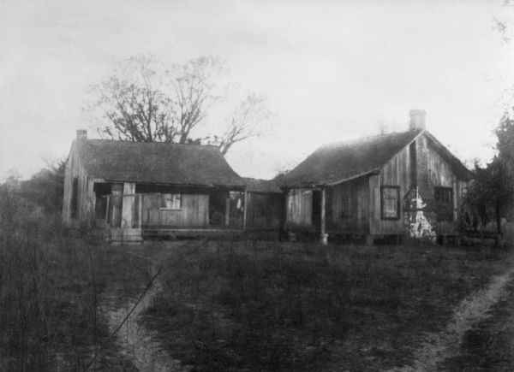
https://www.loc.gov/resource/g3930.cw0117300/
An old cracker house in Ft. Meade, Florida
https://www.floridamemory.com/items/show/140432

Slide 16
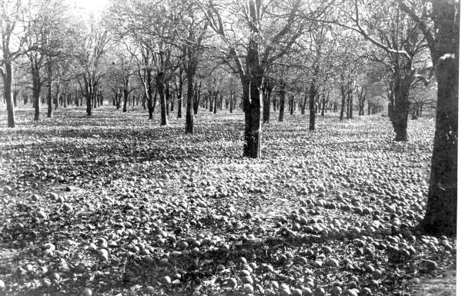
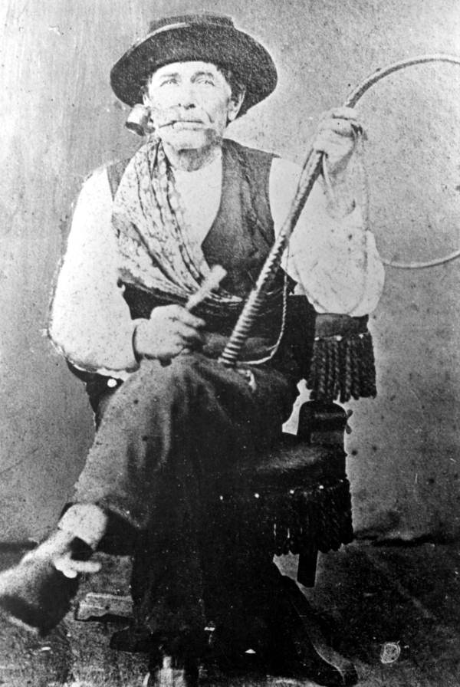
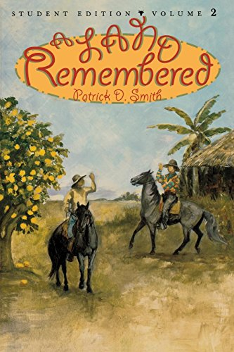
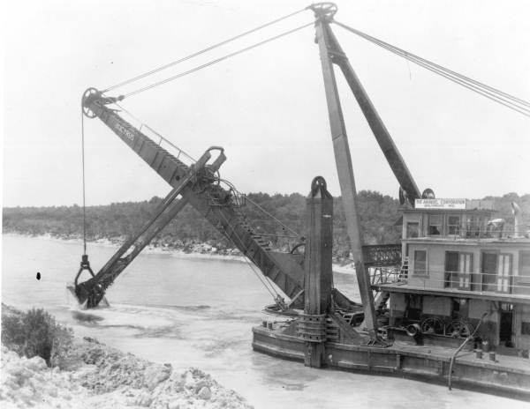
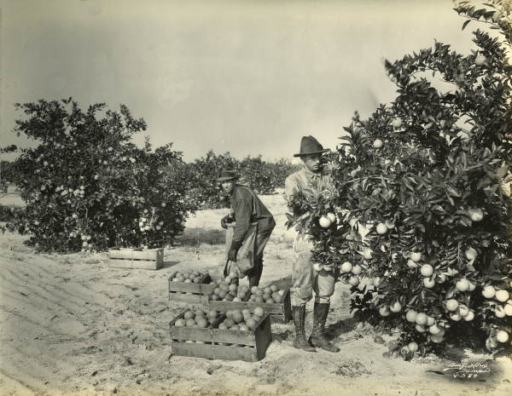
Florida Memory

Slide 17
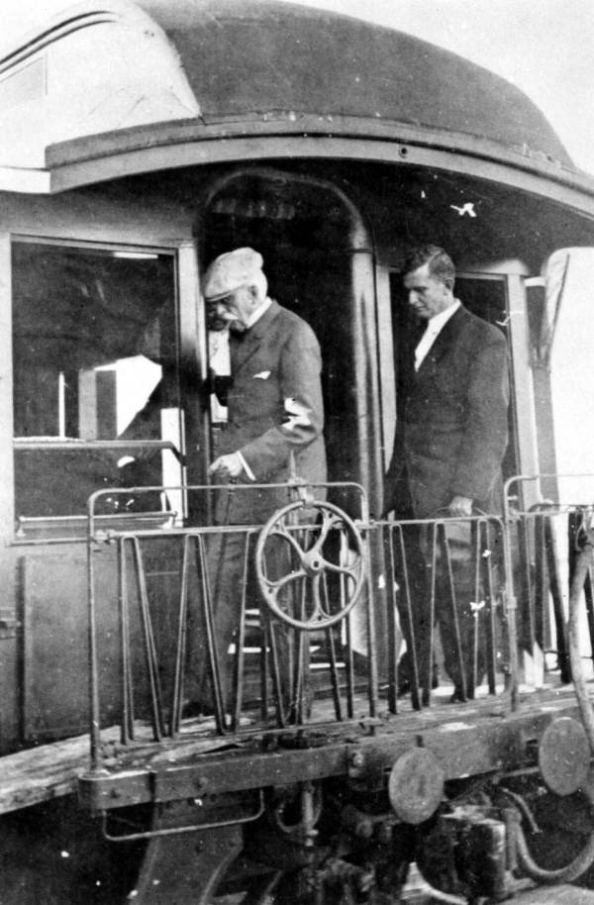
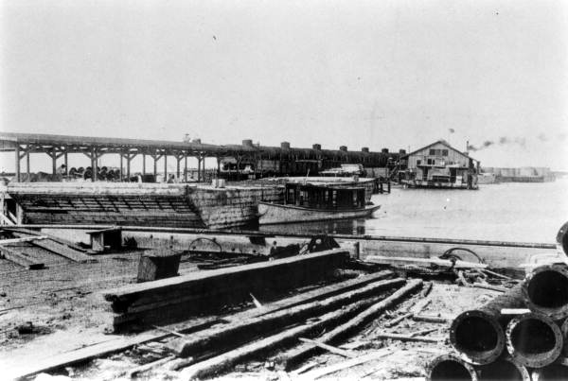
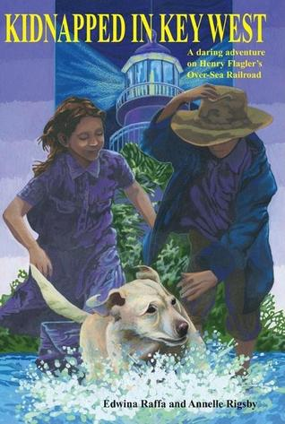
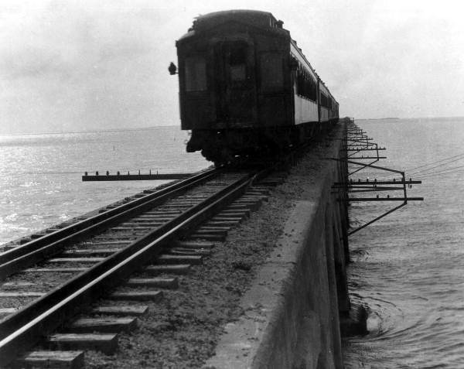
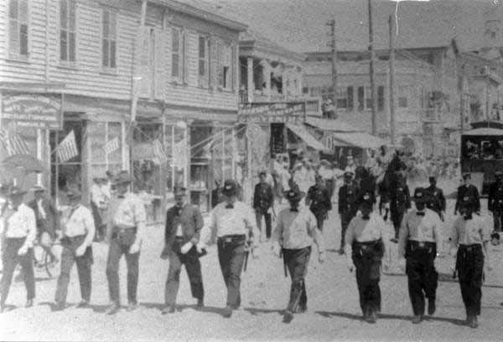
Florida Memory

Slide 18
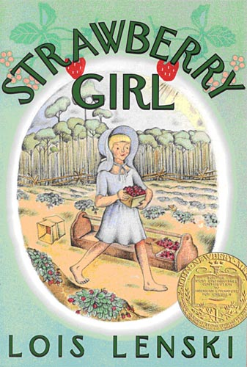
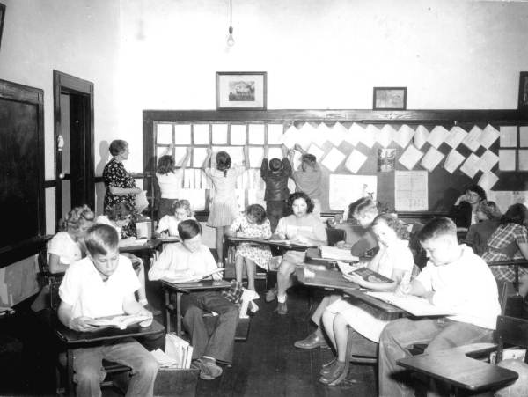
https://www.floridamemory.com/blog/2016/01/15/strawberry-schools/

Slide 19
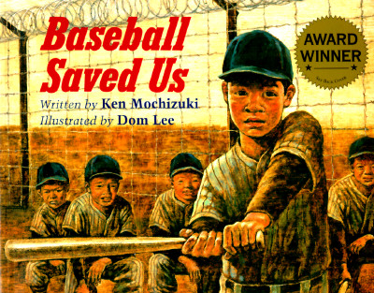
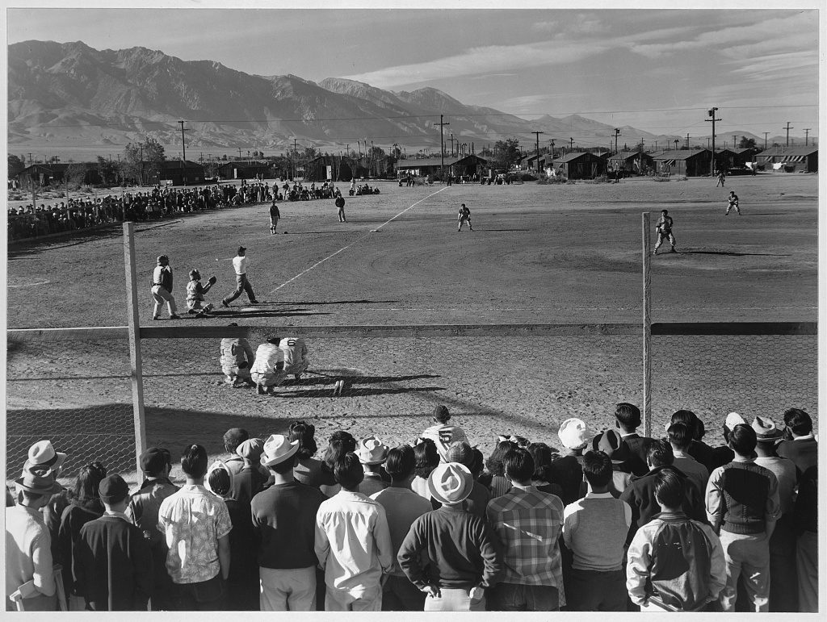
https://blogs.loc.gov/loc/2018/05/baseball-americana-playing-behind-barbed-wire/

Slide 20
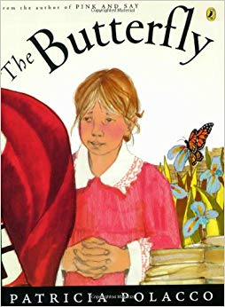
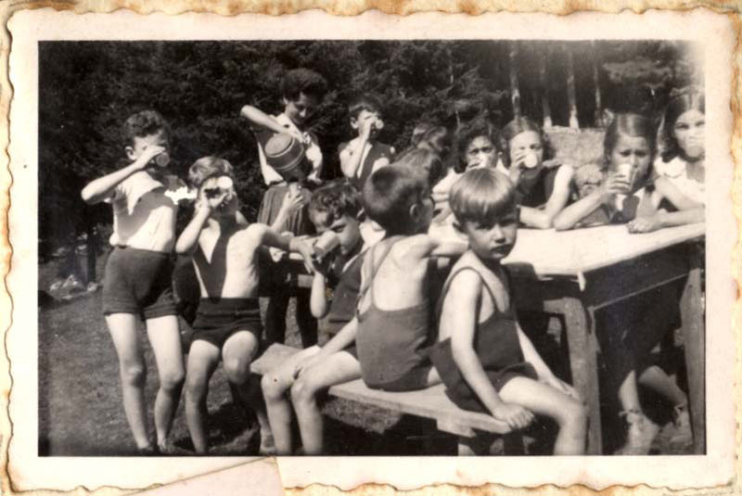
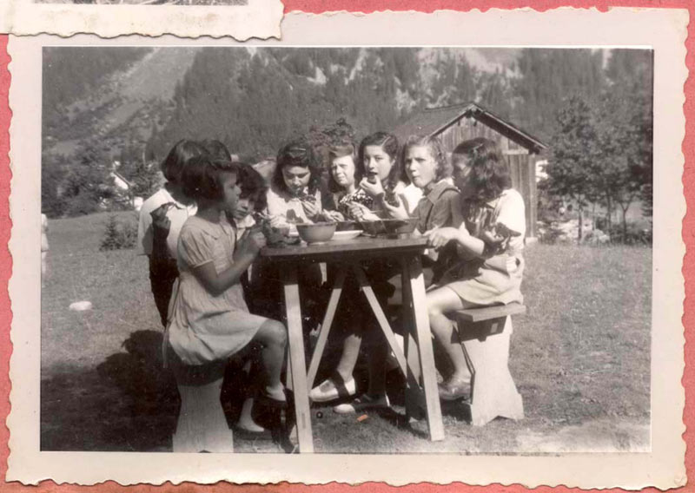
https://www.loc.gov/collections/totenberg-wilk/articles-and-essays/elizabeth-wilk-comments/
https://www.yadvashem.org/articles/general/hidden-children.html

Slide 21
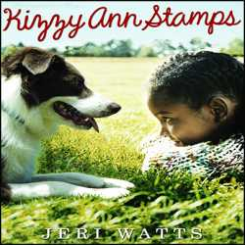
https://www.loc.gov/exhibits/civil-rights-act/multimedia/kennedys-civil-rights-address.html
Notes:
In 1963, as Kizzy Ann prepares for her first year at an integrated school, she worries about the color of her skin, the scar running from the corner of her right eye to the tip of her smile, and whether anyone at the white school will like her. She writes letters to her new teacher in a clear, insistent voice, stating her troubles and asking questions with startling honesty.

Slide 22
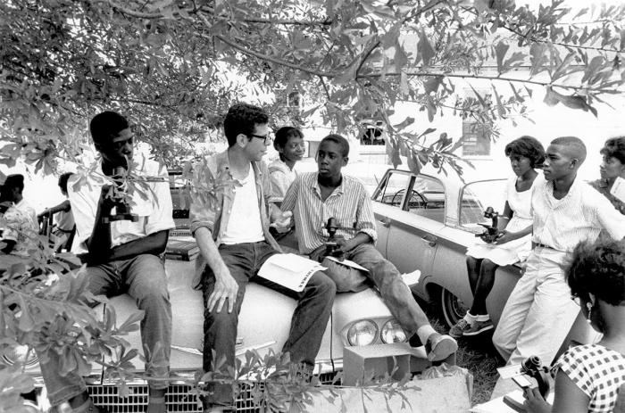
https://www.loc.gov/folklife/civilrights/survey/view_collection.php?coll_id=2501
Photo credit: Matt Herron/Take Stock/The Image Works
https://www.tolerance.org/magazine/spring-2013/no-school-like-freedom-school
Notes:
12-year-old Gloriana Hemphill’s birthday coincides with the United States and every year she celebrates at the town public pool, but in 1964 the pool stays mysteriously closed. As she tries to make sense of what is happening, her older sister gets involved with a young Freedom Fighter and things start to get complicated.

Slide 23
Apol, L., Sakuma, A., Reynolds, T. M., & Rop, S. K. (2003). "When can we make paper cranes?": Examining pre-service teachers' resistance to critical readings of historical fiction. Journal of Literacy Research, 34(4), 429-464.
Crocco, M. S. (2005). Teaching Shabanu: The challenges of using world literature in the US social studies classroom. Journal of Curriculum Studies, 37(5), 561-582.
Harold, J. (2003). Flexing the imagination. The Journal of Aesthetics and Art Criticism, 61(3), 247-257.
Harris, R., & Foreman-Peck, L. (2004). 'Stepping into other people's shoes': Teaching and assessing empathy in the secondary history curriculum. International Journal of Historical Learning, Teaching and Research, 4(2), 1-14.
Levstik, L. (1989). Historical narrative and the young reader. Theory into Practice, 28,
114-119.
Peck, C. & Seixas, P., (2004). Teaching historical thinking. In A. Sears, & I. Wright (Eds.), Challenges and prospects for Canadian social studies (pp. 109-117). Vancouver: Pacific Educational Press.
Purdin, T. (2014). A study of effects on literacy, in fifth grade and eighth grade students’ reading fcat scores, as a result of using historical thinking strategies in the classroom. (Doctoral dissertation, Argosy Sarasota.)
Stripling, Barbara K., "Teaching the Voices of History Through Primary Sources and Historical Fiction: A Case Study of Teacher and Librarian Roles" (2011).The School of Information Studies- Dissertations. Paper 66.

Slide 24
Thank you!
tammarapurdin@flche.net

