Slide 1
The power of agentic women and sources
Dr. Tammara Purdin, Florida Council for History Education
NCHE 2019

Slide 2
Library of Congress Primary Sources
Essential Questions:
Why was it important for females to express their opinions?
To what extent did they make a difference in our history?
http://www.loc.gov

Slide 3
Florida Standards
Benchmark# | Description
LAFS.1112.RI.3.8 | Delineate and evaluate the reasoning in seminal U.S. texts, including the application of constitutional principles and use of legal reasoning (e.g., in U.S. Supreme Court majority opinions and dissents) and the premises, purposes, and arguments in works of public advocacy (e.g., The Federalist, presidential addresses).
LAFS.1112.RI.3.9 | Analyze seventeenth-, eighteenth-, and nineteenth-century foundational U.S. documents of historical and literary significance (including The Declaration of Independence, the Preamble to the Constitution, the Bill of Rights, and Lincoln’s Second Inaugural Address) for their themes, purposes, and rhetorical features.
LAFS.1112.W.3.9 | Draw evidence from literary or informational texts to support analysis, reflection, and research.
SS.2.C.3.1 | Identify the Constitution as the document which establishes the structure, function, powers, and limits of American government.
SS.3.C.1.3 | Explain how government was established through a written Constitution.
SS.5.A.5.10 | Examine the significance of the Constitution including its key political concepts, origins of those concepts, and their role in American democracy.
SS.5.C.1.2 | Define a constitution, and discuss its purposes.
SS.7.C.1.5 | Identify how the weaknesses of the Articles of Confederation led to the writing of the Constitution.
SS.7.C.2.5 | Distinguish how the Constitution safeguards and limits individual rights.
SS.8.A.3.11 | Analyze support and opposition (Federalists, Federalist Papers, AntiFederalists, Bill of Rights) to ratification of the U.S. Constitution.
SS.912.C.1.1 | Evaluate, take, and defend positions on the founding ideals and principles in American Constitutional government.
SS.912.C.3.1 | Examine the constitutional principles of representative government, limited government, consent of the governed, rule of law, and individual rights.
SS.912.C.3.11 | Contrast how the Constitution safeguards and limits individual rights.
SS.912.C.3.7 | Describe the role of judicial review in American constitutional government.
SS.912.W.2.18 | Describe developments in medieval English legal and constitutional history and their importance to the rise of modern democratic institutions and procedures.

Slide 4
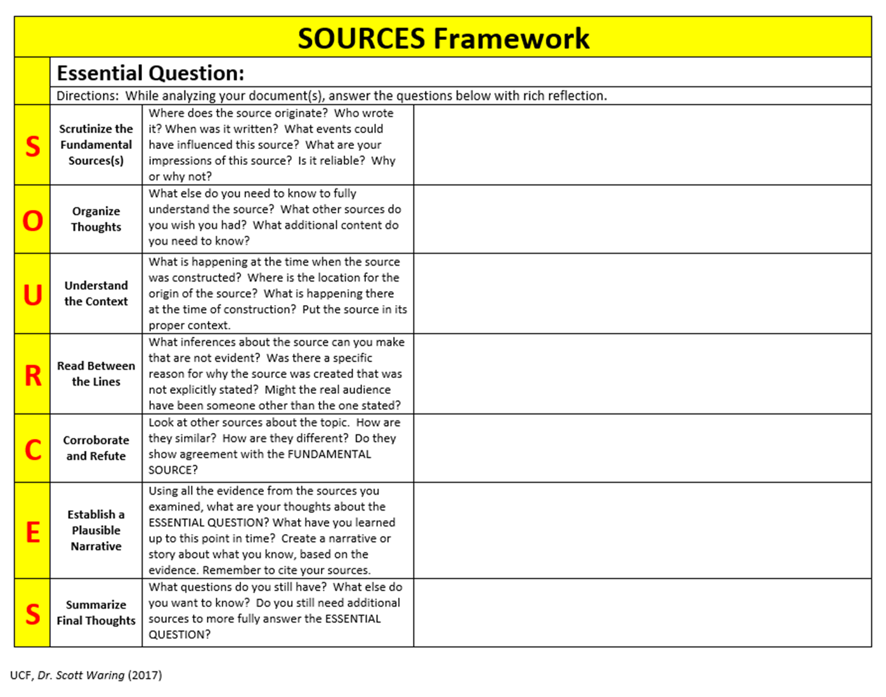

Slide 5
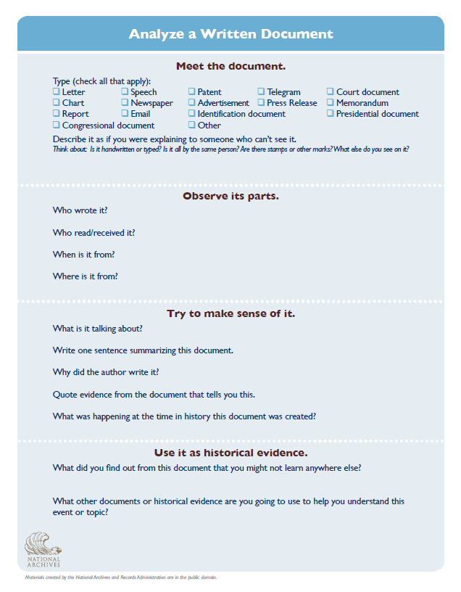
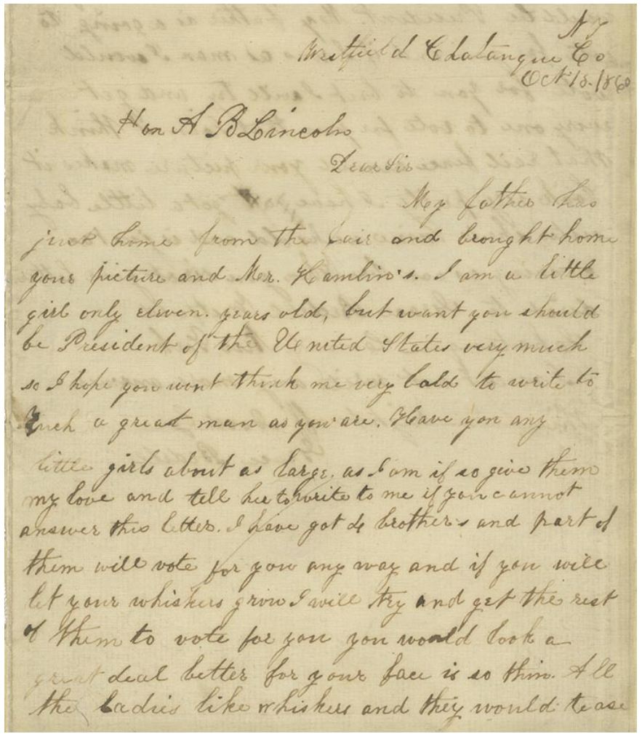
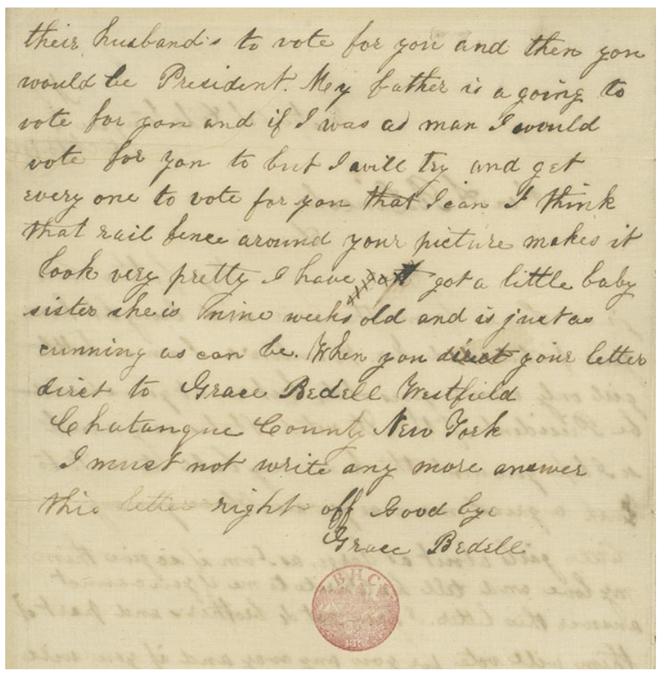
Working with novice-level historical thinkers
Grace Bedell to Abraham Lincoln, October 15, 1860. Holograph letter. On loan from Detroit Public Library, Burton Historical Collection (069.00.01) Digital ID # al0069_02 http://www.loc.gov/exhibits/lincoln/candidate-lincoln.html#obj0
Essential Question: In what ways was Grace Bedell a historical agent?
Letter written by Grace Bedell to Abraham Lincoln on October 15, 1860, about his need to grow a beard. www.loc.gov/exhibits/lincoln/candidate-lincoln.html

Slide 6
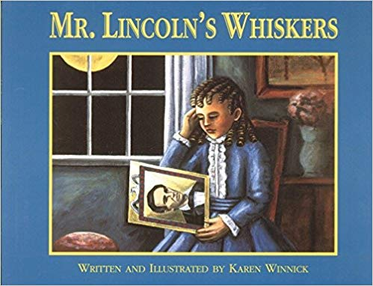
Filling in the Gaps- Connecting Literature to Primary Sources
In order to start filling in the answers and building a foundation of content knowledge, read “Mr. Lincoln’s Whiskers,” by Karen Winnick.

Slide 7
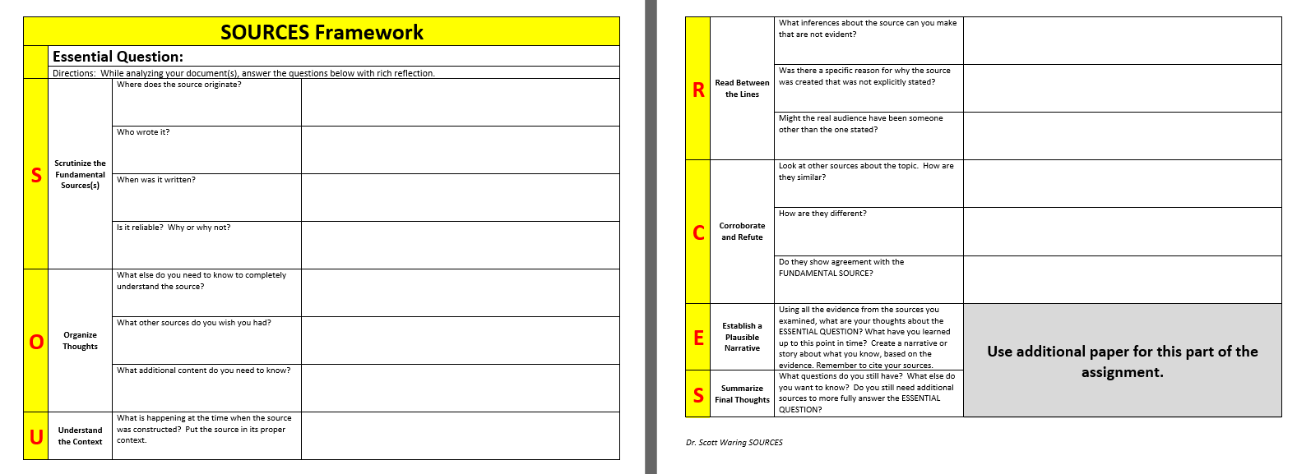
Grace was brave! Lincoln was caring.
Letter to President Lincoln
no
no
Grace Bedell, an 11 year old girl
Grace and P. Lincoln were writing back and forth with each other.
10/18/1860
Yes, because it was from a little girl being honest; from LOC
They corroborate
Did he reply?
yes
A letter from President Lincoln
Election; if Lincoln is elected, country will be split; females couldn’t vote

Slide 8
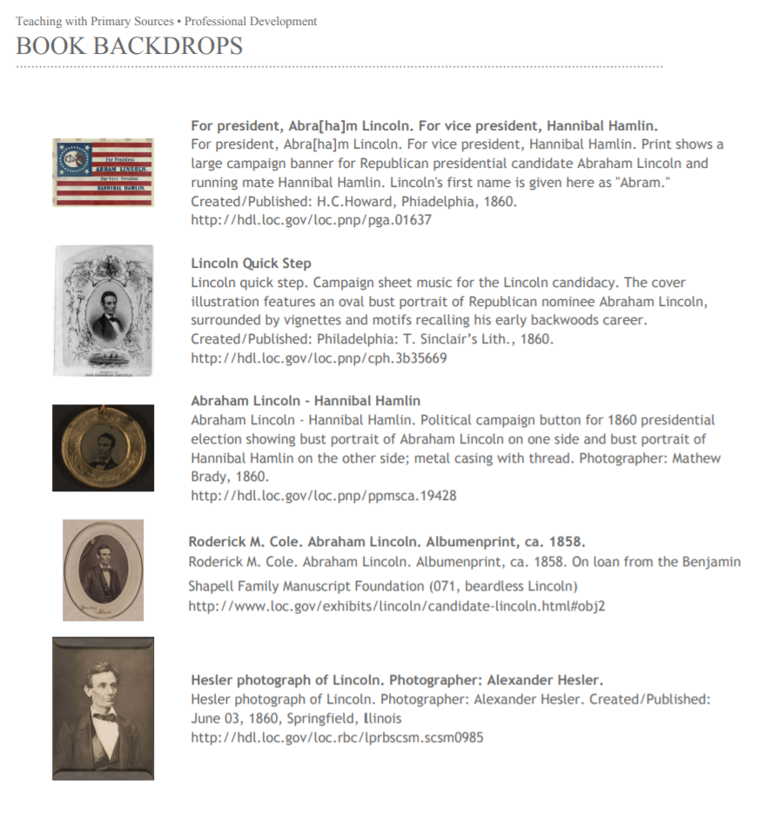
LOC- Mr. Lincoln’s Whiskers
Staff at the Library of Congress developed a lesson plan and primary source set around Mr. Lincoln’s whiskers and various primary sources in their collections, so this is the perfect set of primary sources to utilize.
A book backdrop activity centers around a piece of children’s literature that either focuses explicitly on a historical event or focuses on content that can be tied to other social studies themes.
http://www.loc.gov/teachers/professionaldevelopment/tpsdirect/pdf/Book-Backdrops.pdf

Slide 9
Other resources to be utilized can be found on the “Candidate Lincoln” portion of the Library of Congress’ website: “With Malice Toward None: The Abraham Lincoln Bicentennial Exhibition”, which includes a letter that Grace Bedell wrote to J.E. Boos, 58 years after the event, on May 8, 1918, in which she wrote:
“I think I must have been rather disappointed when my father brought from some meeting a crude and glaring picture of Lincoln and Hamlin. The two were surrounded by way of frame with a rail fence. Searching about in my mind for something which would improve Mr Lincolns face […]."
www.loc.gov/exhibits/lincoln/candidate-lincoln.html

Slide 10
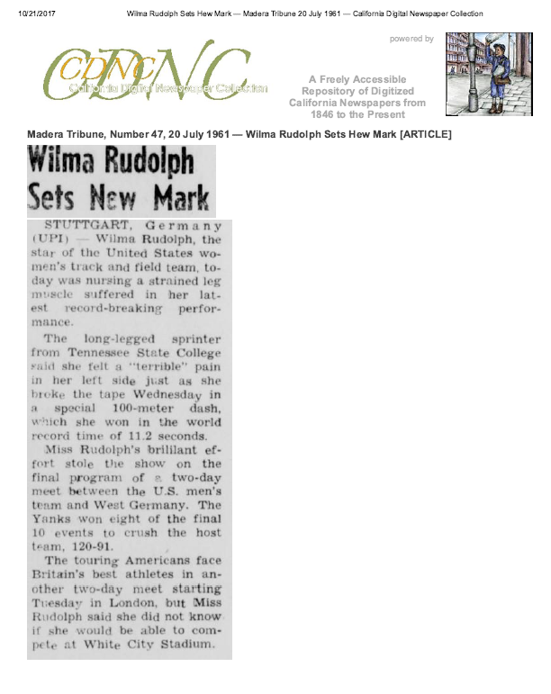
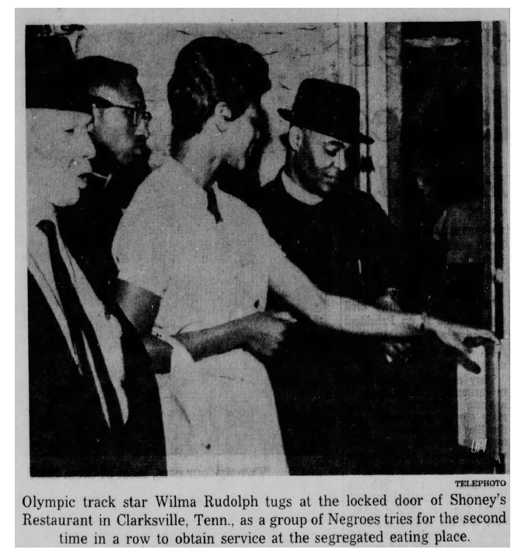
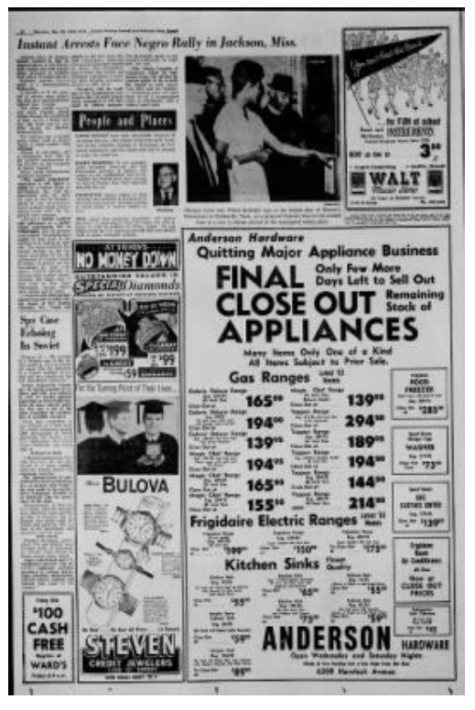
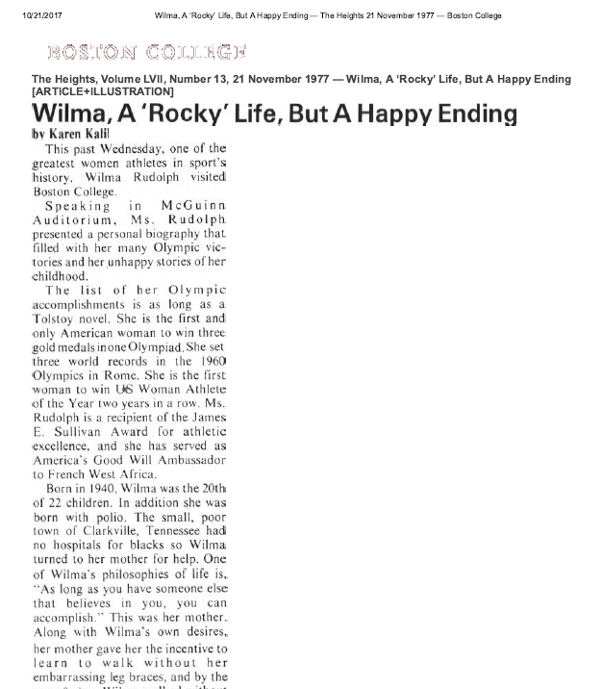
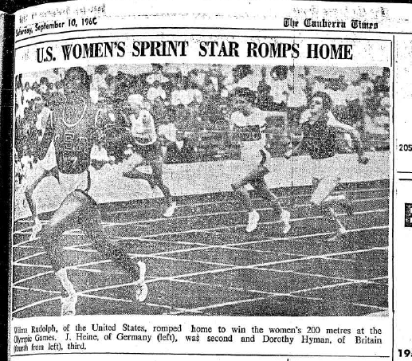
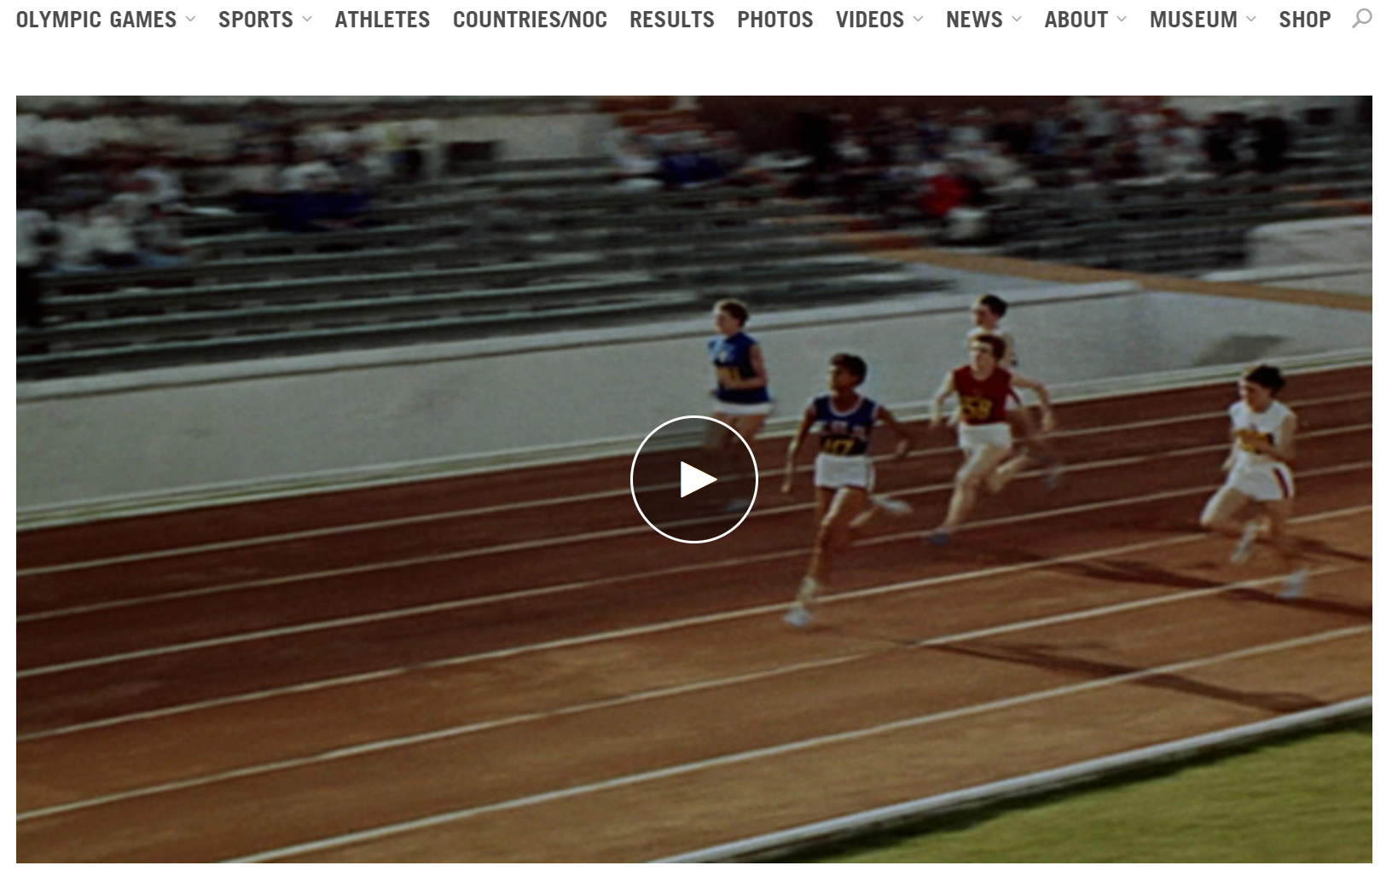
Independent historical inquiry- The S.O.U.R.C.E. Framework
Essential Question: In what ways did Wilma Rudolph serve as a role model and a historical agent and, thus, impact United States history?
https://www.congress.gov/bill/109th-congress/house-bill/1404/text

Slide 11
THANK YOU!
tammarapurdin@flche.net

